Slide 1
IR remote BASED AUTOMATION
Name Enrl. No.
Gaurang Ambasana 160470111004
Dhruvin Chikhaliya 160470111012
Aghera Vishal 160470111002
Sankhavra Krunal 160470111045

Slide 2
List of COMPONENTS used:
Arduino UNO
TSOP1738
IR Remote
Relay Module
Bulb with Holder
16x2 LCD
Power Supply
Connecting Wires

Slide 3
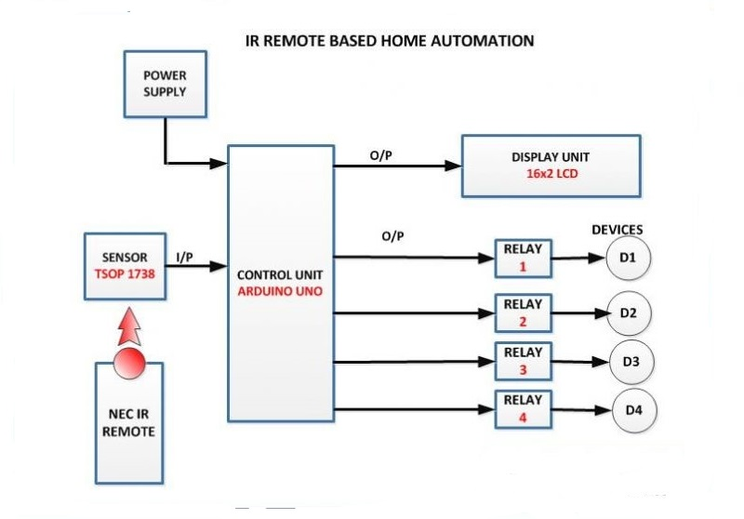
Block Diagram

Slide 4
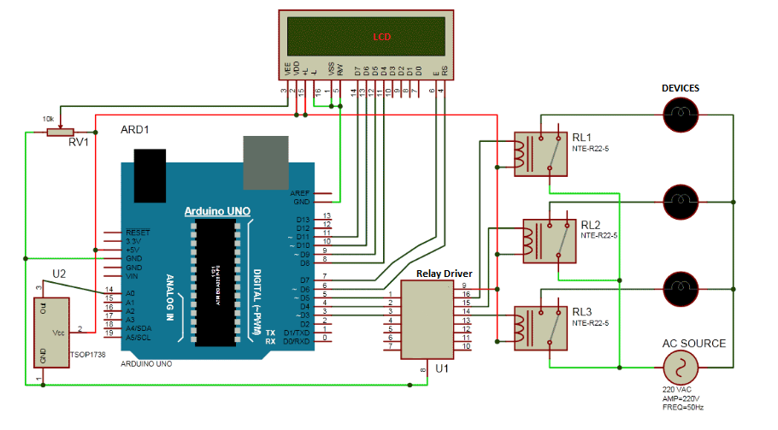
Circuit Diagram

Slide 5
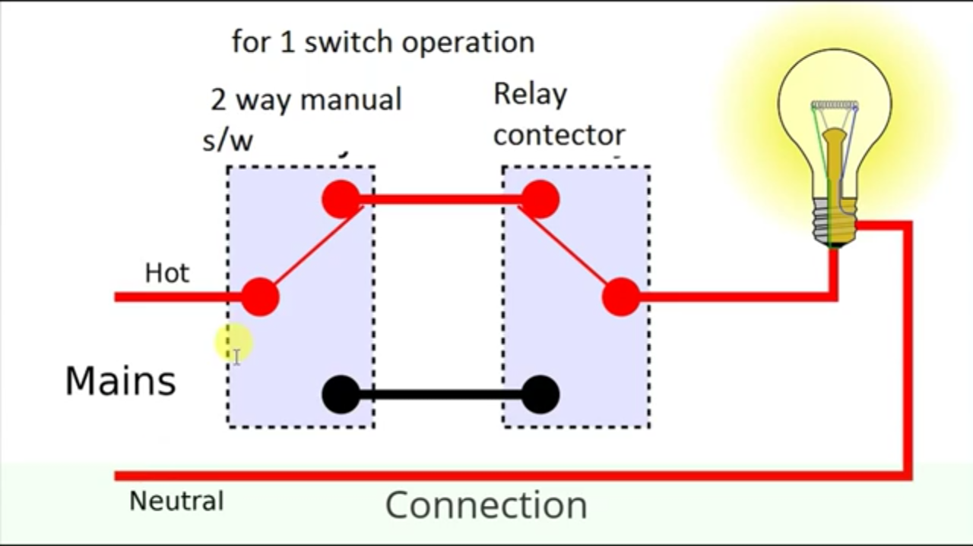
Working

Slide 6
When we press any button of IR Remote then remote sends a code in form of train of encoded pulses using 38Khz modulating frequency.
These pulses are received by TSOP1738 sensor and read by Arduino and then Arduino decodes received train of pulse into a hex value and compares that decoded value with the predefined hex value of the pressed button.
If any match occurs then Arduino perform relative operation and the corresponding result is also displayed on 16x2 LCD by using appropriate commands.
Here in this project we have used 1 bulb, for demonstration which indicates that we can use this for different appliances as well.
we have used toggle [EVEN ODD] method for ON and OFF the single home appliance. Toggle method is nothing but to get that whether the button is pressed even no of times or the odd no of times. This is found by getting the reminder after dividing it by 2 (i%2), if there is some reminder then device will be turned ON and if reminder is 0 then it will be turned OFF.
Odd bit turns the device on & even bit turns the device off.

Slide 7
#include <IRremote.h>
int RECEIVE_PIN = 11;
IRrecv irrecv(RECEIVE_PIN);
decode_results results;
int i=0;
void setup()
{
Serial.begin(250000);
irrecv.enableIRIn();
pinMode(13,OUTPUT);
}
void loop() {
if (irrecv.decode(&results)) {
Serial.println(results.value, HEX);
irrecv.resume();
if(results.value==0xFF30CF)
{
i++;
int x=i%2;
digitalWrite(13, x);
}
}
}

Slide 8
THANK YOU

